Slide 1
GRAD HIRE onboarding
BATCH 2 - JANUARY

Slide 2
BATCH 2 JOINEES
# | Name | Email | Phone | Whether joining or not | Microsoft accounts
1 | Abin Madathil | abinmadathil7@gmail.com | 6282155319 | Yes | abinmadathil7@gmail.com
2 | Adhila Farsana | adhilafarsana@gmail.com | 9072314518 | Yes | adhilafarsana@outlook.com
3 | Adil Mohamed Parayil | adilmohamedparayil@gmail.com | 9072550087 | Yes | adilmohamedparayil@outlook.com
4 | Aiswarya E V | aiswaryaev63@gmail.com | 808620568 | Yes | aiswaryaev2000@outlook.com
5 | Aleena Jayan | aleenajayan2001@gmail.com | 7558845722 | Yes | aleenajayan2001@gmail.com
6 | Arya S | aryasulija@gmail.com | 9747862532 | Yes | aryasulija@outlook.com
7 | Aswanth K | aswanthkr679@gmail.com | 9446568684 | Yes | aswanthkanappally@outlook.com
8 | Deepthi Mohan | deepthimohandeepz99@gmail.com | 7902603895 | Yes | deepthimohandeepz99@outlook.com
9 | Geo Joseph | geojofficial@gmail.com | 7293624453 | Yes | geojofficial@gmail.com
10 | Godwin George U | godwingeorge111@gmail.com | 9188050385 | Yes | godwingeorgeu@outlook.com
11 | Hanna Ann Joseph | hannaaj2000@gmail.com | 7306575280 | Yes | hannaaj2000@outlook.com
12 | Indraja KP | kpindraja20@gmail.com | 9074737497 | Yes | kayaramparambil123@outlook.com
13 | Jithin T | jithinunni420@gmail.com | 7510466878 | Yes | jithinthottoli@outlook.com
14 | Maneesha Krishnan | maneeshakrishnan604@gmail.com | 8943149296 | Yes | maneeshakrishnan604@gmail.com
15 | Mohammed Nazeem C | mhdnazeemc@gmail.com | 8086575836 | Yes | mhdnazeemc@gmail.com
16 | Prasanth J Mathew | prasanthjmathew@gmail.com | 8547026029 | Yes | prasanthjmathew@outlook.com
17 | Sana Parvin | sanaparveenin@gmail.com | 8129396681 | Yes | sanaparveenin@outlook.com
18 | Shesna Jalal | shesnajalal211@gmail.com | 9496886735 | Yes | shesnajalal211@gmail.com
19 | Sreeparna Sreejay | sreeparnasreejay@gmail.com | 8281233816 | Yes | sreeparnasreejay@gmail.com
20 | Sneha Ravindran | sneharavindran1420@gmail.com | 9188428097 | Yes | sneharavindran1420@outlook.com
21 | Thej Kiran P | thejkannur376@gmail.com | 8848917615 | Yes | thejkiran726@gmail.com

Slide 3
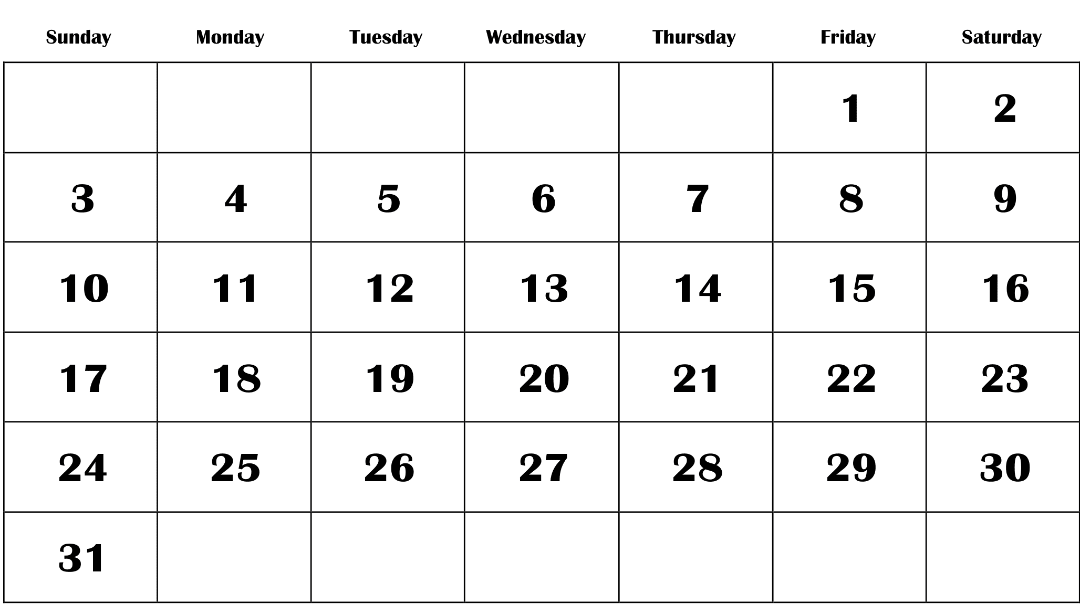
TIMELINE AVAILABLE
DECEMBER
Learning timeline
Doubt clarification session
Mini Project
Review Session

Slide 4
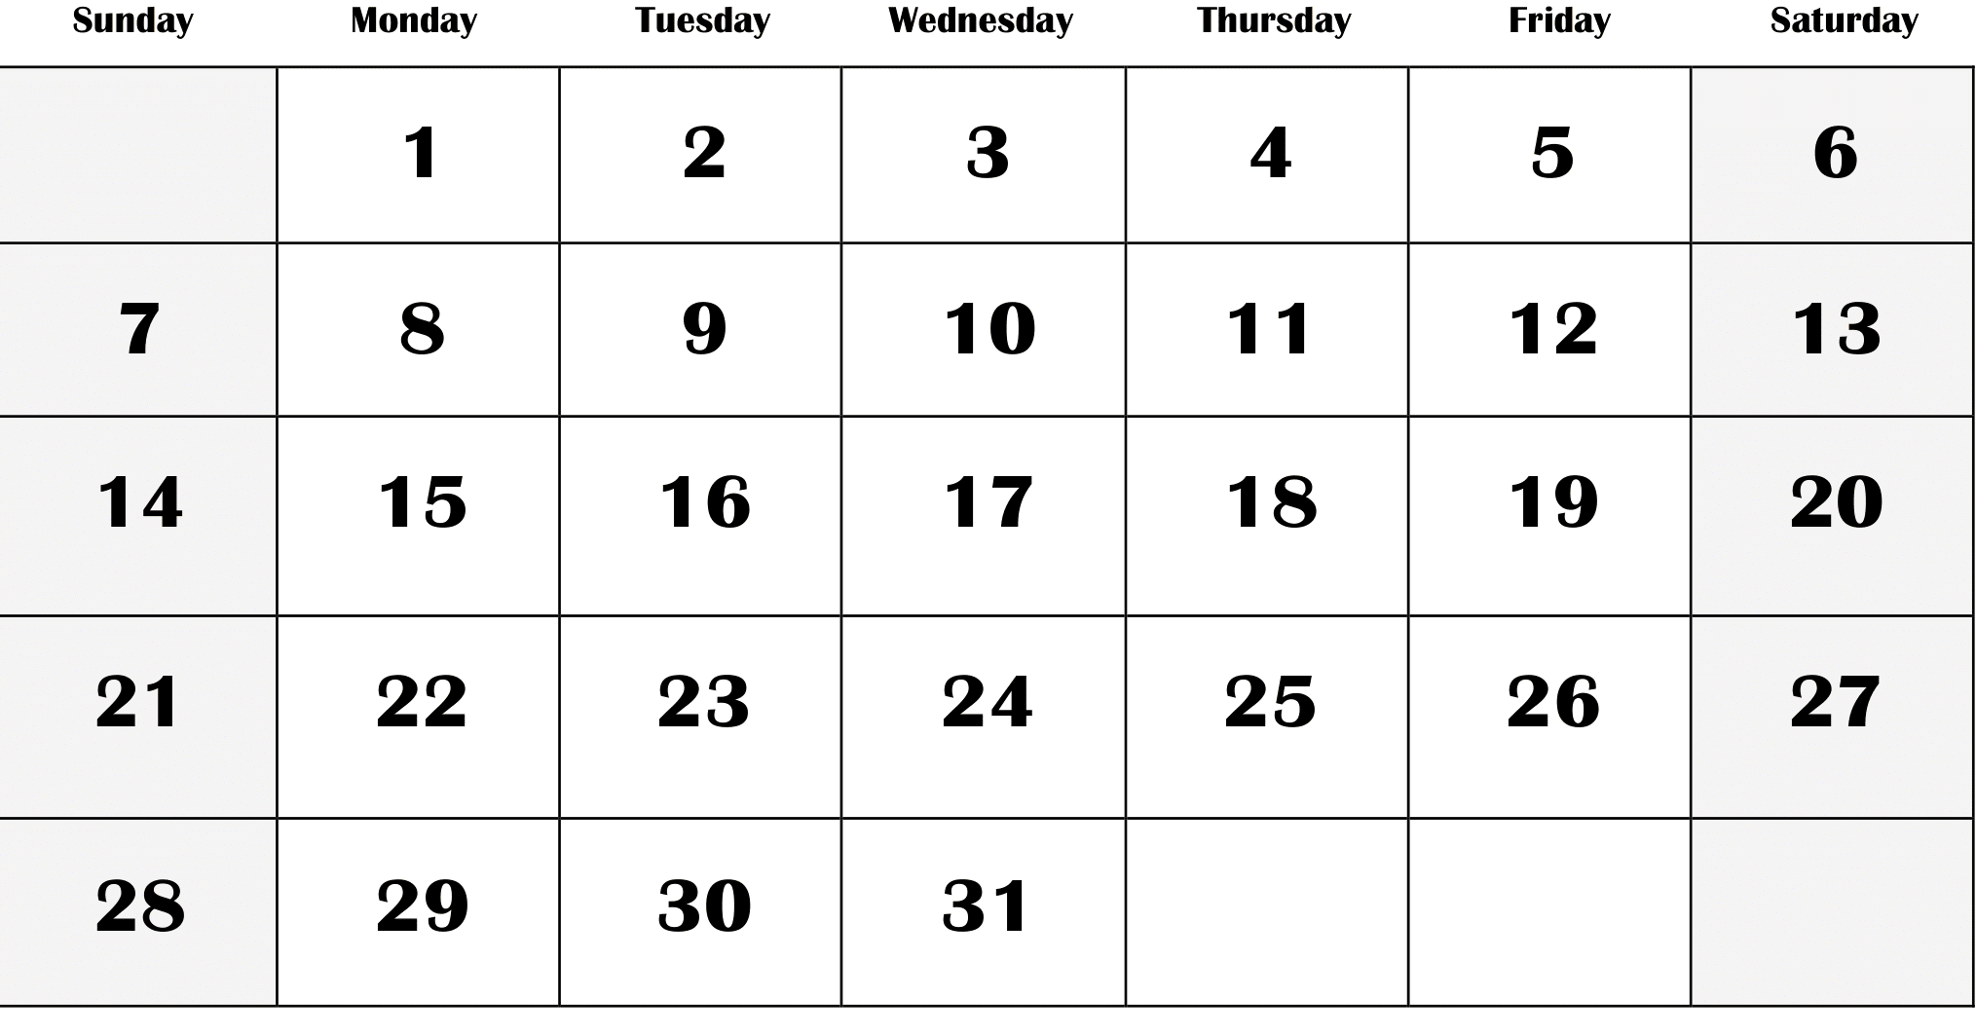
TIMELINE AVAILABLE
JANUARY
Mini Project
Review Sessions

Slide 5

TASKS EXPECTED TO BE COMPLETED
Understand concepts
Utilize provided materials and extra resources
Complete tasks
Review
Clarify doubts

Slide 6
LEARNING PLAN – WEEK 1
DECEMBER
Understand the concepts of HTML and CSS
Utilize the materials:
SharePoint site: 2023GradHireTraining
Materials: HTML CSS
Extra learning materials:Introduction to software development
Review session and task demo on 21-12-2023
TASK: Create your personal Portfolio page using HTML and CSS.
Review Session

Slide 7
LEARNING PLAN – WEEK 2
DECEMBER
Understand the concepts of Database Management
Utilize the materials:
SharePoint site: 2023GradHireTraining
Materials: Database
Extra learning materials: Introduction to software development
Review session and task demo on 28-12-2023
TASK:
Install postgres on your computer
Generate a database model
Normalize the database (at least 2NF)
Establish table mapping
Perform CRUD operations(Create, Read, Update, Delete)

Slide 8
LEARNING PLAN – WEEK 3
DECEMBER
Understand the concepts of Multifile programming
Utilize the materials:
SharePoint site: 2023GradHireTraining
Materials: (to be updated)
Extra learning materials:Introduction to software development
TASK: Create a mini project to use JDBC to perform CRUD operations on MySQL DB for a system via Java.

Slide 9
REVIEW SESSION
There will be a weekly review session every Thursday where the updates and tasks can be presented.

Slide 10
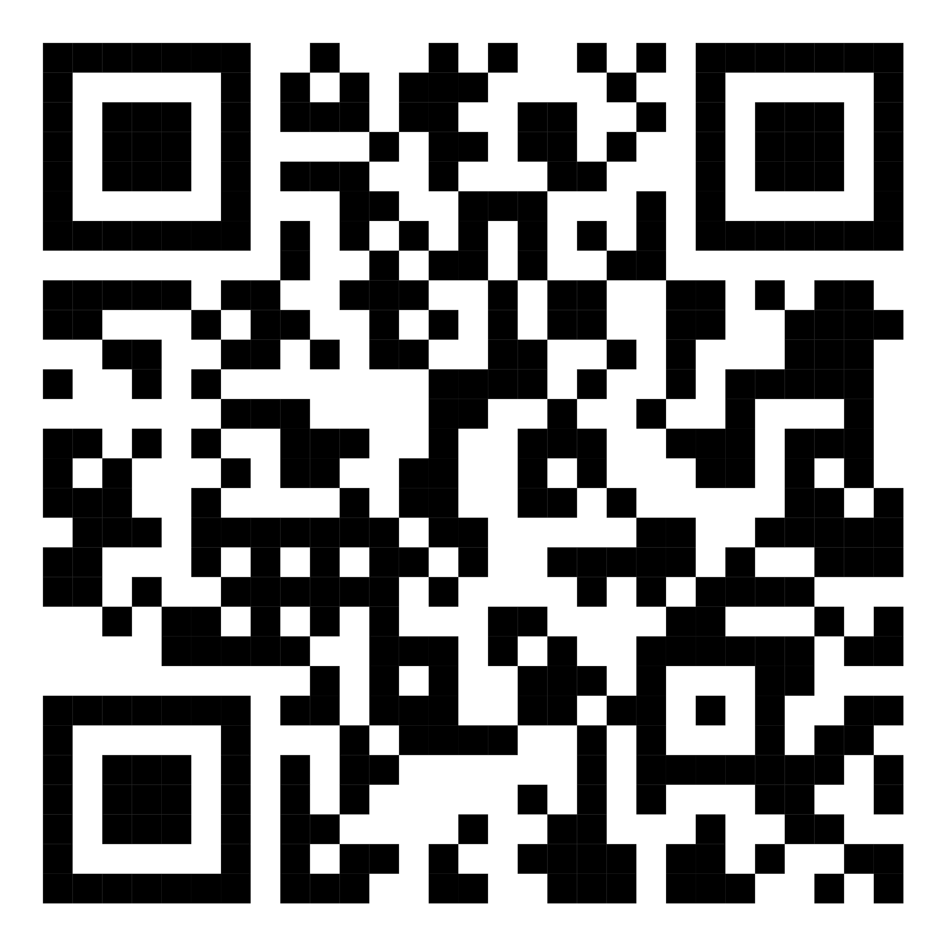
SCAN THE QR AND JOIN THE GROUP

Slide 11
THANK YOU

